Slide 1


Subject Code: SIT-1205
Subject Name: Object Oriented Analysis and Design
Faculty Name: Dr.R.Jeberson Retna Raj
Dr.R.M Gomathi

Slide 2
UNIT 2 OBJECT ORIENTED METHODOLOGIES
Rumbaugh et al.’s Object Modeling Technique - Booch Methodology - Jacobson et al. Methodologies - Patterns - Framework - Unified approach - Unified Modeling Language:Static and Model - UML Diagrams - UML Class Diagram - UML Usecase Diagram - UML Dynamic Modeling - UML Extensibility - UML Metamodel.

Slide 3
Patterns
Vocabulary for exposing the concepts and a language to relate.
Way to describe commonly occurring design solutions.
Definition
Identifies key aspects of a common design structure that make it useful for creating reusable object oriented design.
Provide documentation.
Solution to the recurring problem.
Pattern involves general description of a solution to a recurring problem.
Provides solution and why the solution is needed.
Pattern is considered until it verified to be a recurring problem

Slide 4
Patterns
Proto-pattern problem
“A pattern in waiting” which is not known to recur.
Good pattern
It solves a problem → pattern capture solutions
It is a proven concept → pattern capture solutions with track record, not theories
The solution is not oblivious →solution to the problem indirectly
It describes a relationship →describes deeper system structures and mechanism.
The pattern has a significant human component →s/w serves human comfort.

Slide 5
Patterns
Pattern is divided into two categories
Generative
Generative Pattern – How to generate something
Each pattern is a rule which describes what you have to do to generate entity.
Non-Generative patterns
Non generative pattern – static and passive.
They describe recurring phenomena without necessarily saying how to reproduce them.

Slide 6
Patterns
Pattern template
Name : Good Pattern name (Meaningful)
Problem : Statement of problem that describes its intent.
Context : Precondition.
Forces : Description of relevant forces and constraints.
Solutions : static relationship and dynamic rules.
Example : Helps the reader to understand the pattern use and applicability.
Resulting context : describes post condition and side effects of the pattern.
Rationale : Tell us how the pattern works, why it works, why it is good.
Related patterns
Known users:

Slide 7
Patterns
Anti pattern :
Represents worst practice or lesson learned
Capturing pattern
-Process of looking for pattern to document called pattern mining.

Slide 8
Frameworks
Developer work on new program begin by filling in new domain-specific code inside the older structure.
Business consultant never build data model from scratch.
Definition
Framework is a way of presenting a generic solution to a problem that can be applied to all levels in a development.
Framework is a set of cooperating classes that make up a reusable design.
Framework encompasses several design pattern
Framework is executable software
Physical in nature
Physical realization

Slide 9
Frameworks
Pattern
Knowledge and experience about the software.
Logical in nature
Instruction for how to implement solution.

Slide 10
Difference between design pattern and framework
Design patterns are more abstract than framework.
Design pattern are smaller architectural elements than framework.
Design patterns are less specialized than frameworks.

Slide 11
Unified Approach
The unified approach (UA) used to describe, model, and document the software development process.
The idea behind the UA is to combine the best practices, processes, methodologies, and guidelines along with UML notations and diagrams for better understanding object-oriented concepts and system development.
The unified approach to software development revolves around the following processes and concepts (see Fig ). The processes are:
Use-case driven development
Object-oriented analysis
Object-oriented design
Incremental development and prototyping
Continuous testing

Slide 12
Unified Approach
The methods and technology employed include
Unified modeling language used for modeling.
Layered approach.
Repository for object oriented system development patterns and frameworks
Component based development.

Slide 13
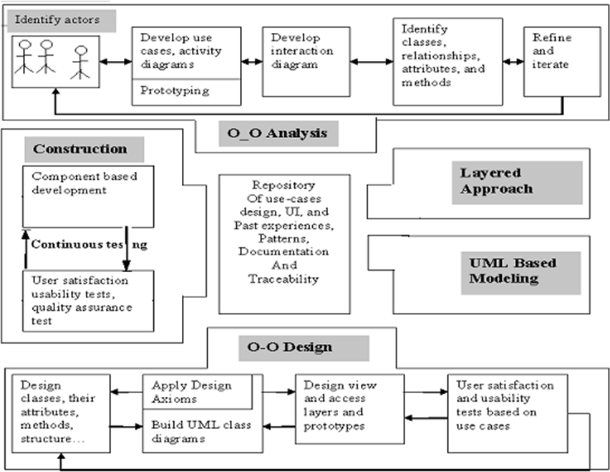
Unified Approach

Slide 14
Unified Approach
Object-oriented Analysis
Analysis is the process of extracting the needs of a system and what the system must do to satisfy the users' requirements.
The goal of object-oriented analysis is to first understand the domain of the problem and the system's responsibilities by understanding how the users use or will use the system.
This is accomplished by constructing several models of the system.
These models concentrate on describing what the system does rather than how it does it.
Separating the behavior of a system from the way it is implemented requires viewing the system from the user's perspective rather than that of the machine.

Slide 15
Unified Approach
OOA Process consists of the following Steps:
Identify the actors
Develop a simple business process model using UML activity diagram
Develop use cases
Develop interaction diagram
Identify classes

Slide 16
Unified Approach
OBJECT-ORIENTED DESIGN
OOD Process consists of:
Designing classes, their attributes, methods, associations, structures and protocols, apply design axioms
Design the Access Layer
Design and prototype User interface
User Satisfaction and Usability Tests based on the Usage/Use Cases
Iterate and refine the design

Slide 17
Unified Approach
Iterative Development And Continuous Testing
Repeat the entire process.
Usage scenarios becomes test scenarios.
You must iterate and reiterate until, eventually, you are satisfied with the system.
Modeling Based On The Unified Modeling Language
The UA uses the UML to describe and model the analysis and design phases of system development.
The UA Proposed Repository
In a repository that allows the maximum reuse of previous experience and previously defined objects, patterns, frameworks, and user interfaces in an easily accessible manner with a completely available and easily utilized format.
The advantage of repositories is that for reuse.

Slide 18
Unified Approach
The UA Proposed Repository
Reuse benefits
Reuse previously defined pattern, framework and user interface
Assembling components
Increase the quality of product.
Reduce cost.
Accessible to many people

Slide 19
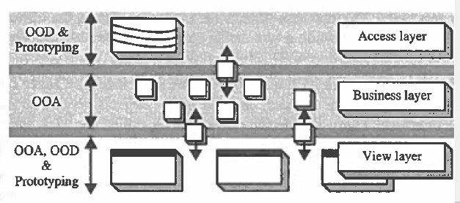
Unified Approach
The Layered Approach to Software Development
Most systems developed with today's CASE tools or client-server application development environments tend to lean toward what is known as two-layered architecture: interface and data (see Fig ).
In a two-layered system, user interface screens are tied to the data through routines that sit directly behind the screens

Slide 20
Unified Approach
The three-layered approach consists of
a view or user interface layer,
a business layer, and
an access layer
The business layer
It contains all the objects that represent the business (both data and behavior).
This is where the real objects such as Order, Customer, Line item, Inventory, and Invoice exist.
Most modem object oriented analysis and design methodologies are generated toward identifying these kinds of objects

Slide 21
Unified Approach
user interface layer
It consists of objects with which the user interacts as well as the objects needed to manage or control the interface.
The user interface layer also is called the view layer.
This layer typically is responsible for two major aspects of the applications:
The Access layer :
The access layer contains objects that know how to communicate with the palce where the data actually reside, whether it be a relational database mainframe, internet or file.
The Access layer has 2 major responsiblities.

Slide 22
Unified Approach
Translate request : The access layer must be able to translate any data-related requests from the business layer into the appropriate protocol for data access.
Translate results: Layer also must ne able to translate the data retrieved back into the appropriate business objects and pass those objects back up into the business layer. Access objects are identified during object oriented design.

Slide 23
Unified Modeling Language

Slide 24
Unified Modeling Language
A model is an abstract representation of a system, constructed to understand the system prior to building or modifying it.
Most of the modeling techniques involve graphical languages.
Modeling frequently is used during many of the phases of the software life cycle, such as analysis, design, and implementation.
For example, Objectory is built around several different models:

Slide 25
Unified Modeling Language
Use-case model. The use-case model defines the outside (actors) and inside (use case) of the system's behavior.
Domain object model. Objects of the "real" world are mapped into the domain object model.
Analysis object model. The analysis object model presents how the source code (i.e., the implementation) should be carried out and written.
Implementation model. The implementation model represents the implementation of the system.
Test model. The test model constitutes the test plans, specifications, and reports
Modeling is an iterative process.

Slide 26
Unified Modeling Language
The unified modeling language is a language for specifying, constructing, visualizing, and documenting the software system and its components.
The UML is a graphical language with sets of rules and semantics
The rules and semantics of a model are expressed in English, in a form known as object constraint language (OCL).
OCL is a specification language that uses simple logic for specifying the properties of a system.

Slide 27
Unified Modeling Language
The UML is not intended to be a visual programming language in the sense of having all the necessary visual and semantic support to replace programming languages.
However, the UML does have a tight mapping to a family of object-oriented languages, so that you can get the best of both worlds.
UML Uses:
Trace external interactions with the software
Plan the internal behavior of the application
Study the software structure
View the system architecture
Trace behavior down to physical components

Slide 28
Unified Modeling Language
Why Modeling
Blue print
Clarity
Familiarity
Maintenance
Simplification

Slide 29
Unified Modeling Language
Advantages of Modeling
Easy to express complex ideas
Reduce complexity
Enhance & reinforce learning and training
Low cost
Easy to change the model

Slide 30
UML Diagrams
The UML defines nine graphical diagrams:
Class diagram (static)
Use-case diagram
Behavior diagrams (dynamic):
3.1. Interaction diagram:
3.1.1. Sequence diagram
3.1.2. Collaboration diagram
3.2. State chart diagram
3.3. Activity diagram
Implementation diagram:
Component diagram
Deployment diagram

Slide 31
Class Diagram
Class Diagram
Class →a set of objects that share the same attributes, operations & relationships
Referred object modeling
It is a static analysis diagram
Show static structure
Describe the structure and relationship among object
Determine what behavior fall within and outside.
It represented by a compartmentalized rectangle.
It shows the structure of your software.

Slide 32
Class Diagram
3 compartments
1. Top
2. Middle
3. Bottom
1. Top - shows class name
2. Middle - shows class attributes
3. Bottom -shows class operation

Slide 33
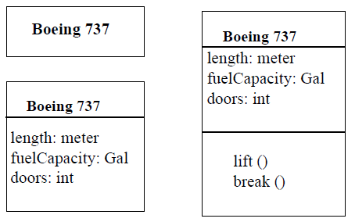
Class Diagram
Attributes
Defines the characteristics or structure of a class.
Displayed in the middle of the compartmentalized rectangle.
Operation
The service provide by the class
Displayed in the bottom of the compartmentalized rectangle.
In class notation, either or both the
attributes and operation compartments may be suppressed.

Slide 34
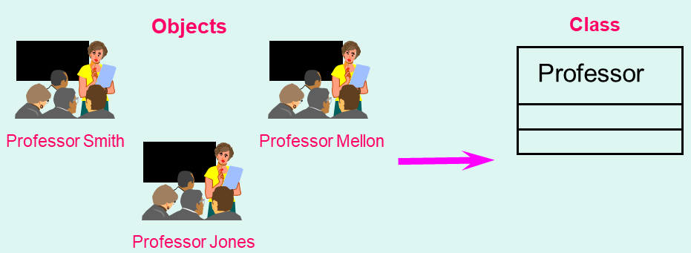
Object diagram
Instance of class diagram
Same diagram as class diagram
A class diagram with object and no classes is an object diagram.

Slide 35
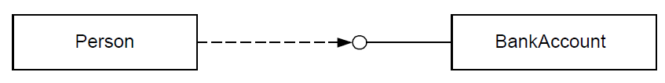
Class Diagram
Class Interface Notation
Class interface notation is used to describe the externally visible behavior of a class.
For example, an operation with a public visibility.
Example, Person object may need to interact BankAccount object.

Slide 36
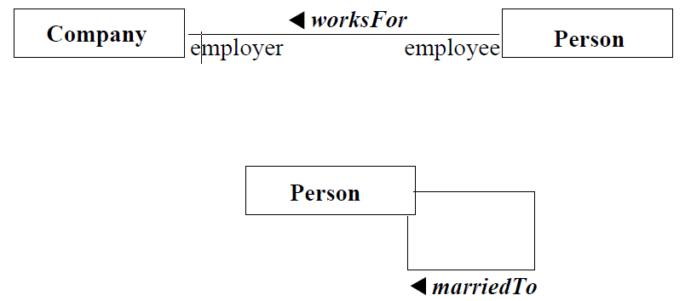
Class Diagram
Binary Association Notation
A binary association is drawn as a solid path connecting two classes or both ends may be connected to the same class.

Slide 37
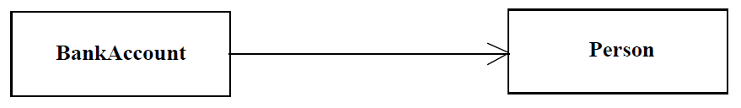
Class Diagram
Association Role
A simple association—the technical term for it is binary association—is drawn as a solid line connecting two class symbols.
The end of an association, where it connects to a class, shows the association role.
In the UML, association is represented by an open arrow.
Navigation describes with unfilled arrow head.

Slide 38
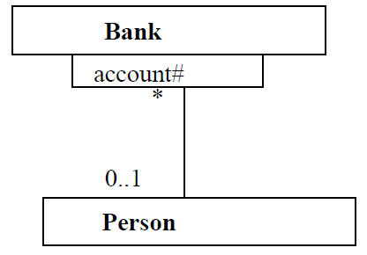
Class Diagram
Qualifier
A qualifier is an association attribute. For example, a person object may be associated to a Bank object.
An attribute of this association is the account#.
The account# is the qualifier of this association.
Qualifier small rectangle attached to end of an association path.

Slide 39
Class Diagram
Multiplicity
Multiplicity specifies the range of allowable associated classes.
It is given for roles within associations, parts within compositions, repetitions, and other purposes.
lower bound .. upper bound.
0..1
0..*
1..3,7..10,15,19..*

Slide 40
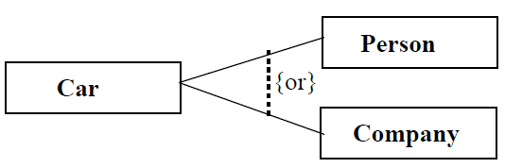
Class Diagram
OR Association
Any instance of the class may participate in atmost, one of the association at one time.
Example : a car is associated with a person or a company

Slide 41
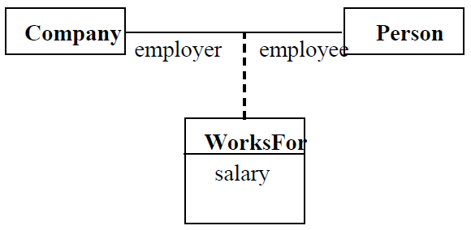
Class Diagram
Association Class
An association class is an association that also has class properties.
An association class is shown as a class symbol attached by a dashed line to an association path.

Slide 42
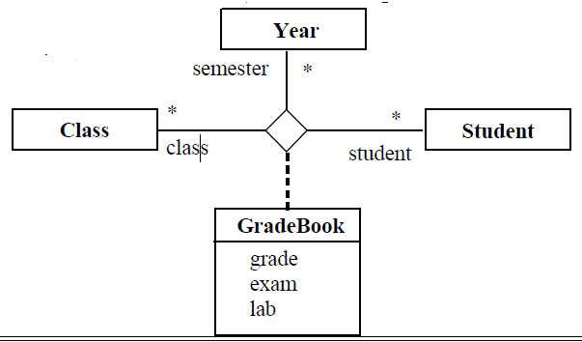
Class Diagram
N-ary association : Is a form of association
An n-ary association is an association among more than two classes.
Symbol diamond symbol used
Aggregation and Composition
attached to the end of the path indicate aggregation
Since n-ary association is more difficult to understand, it is better to convert an n-ary association to binary association.

Slide 43
Class Diagram
Aggregation
Aggregation is a form of association.
A hollow diamond is attached to the end of the path to indicate aggregation.

Slide 44
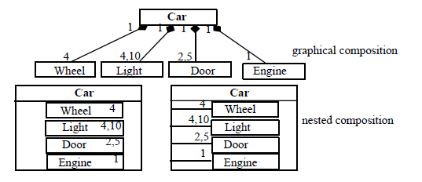
Class Diagram
Composition
Composition, also known as the apart- of, is a form of aggregation with strong ownership to represent the component of a complex object.
The UML notation for composition is a solid diamond at the end of a path.

Slide 45
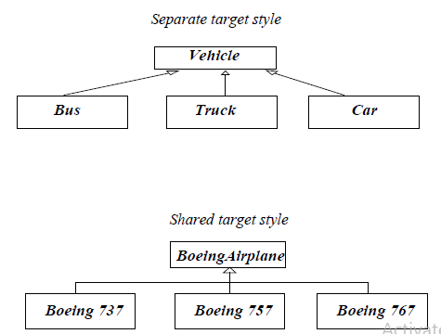
Class Diagram
Generalization
Generalization is the relationship between a more general class and a more specific class.
Generalization is displayed as directed line with a closed, hollow arrowhead at the superclass end.

Slide 46
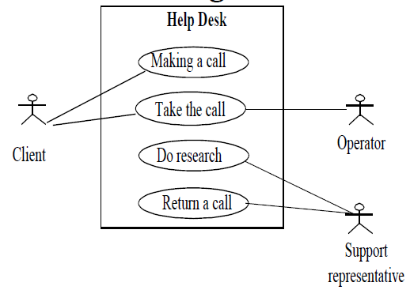
Use Case Diagram
Sequence of transactions.
The description of a use case defines what happens in the system when the use case is performed.
Each transaction invoked from outside the system (actor) and internal objects to interact with one another.
Defines the outside (actors) and inside (use case) of the system's behavior.

Slide 47
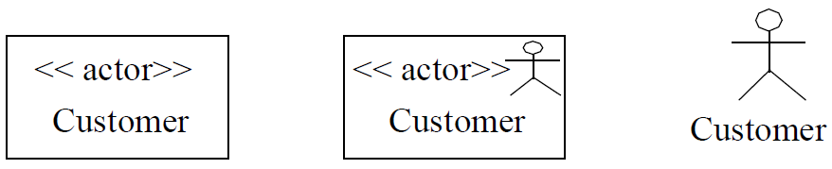
Use Case Diagram
Use case notation : ellipse contains the name of the use case.
Actor Notation :
The three representations of an actor are equivalent.

Slide 48
Use Case Diagram
Three relationships are shown
1. Communication : Solid path between actor and use case symbols
2. Uses : uses relationship between use cases.
3. Extends : one use case is similar to another.

Slide 49
UML Dynamic Modeling (Behavioral Diagram)
Interaction diagrams:
– Sequence diagrams
– Collaboration diagrams
Statechart diagrams
Activity diagrams

